Slide 1

Topic: Support Vector Machine
Department of Computer Science & Engineering
Summer 2022
MCSE 642: DATA MINING
Group D
MCE 079 05534 Rokibul Hasan
MCE 079 05535 Sumon Kumar Ghosh
MCE 079 05536 Shyed Shahriar Housaini
MCE 079 05537 Anjan Chandra Das
MCE 079 05538 Abdul Bari

Slide 2
Content:
Support Vector Machine
Support Vector Machine Background
Support Vector Machines Algorithm
Types of Support Vector Machine
Linear SVM Example
Non-Linear SVM Example
Applicaion of SVM
Pros & Cons
Conclusion

Slide 3
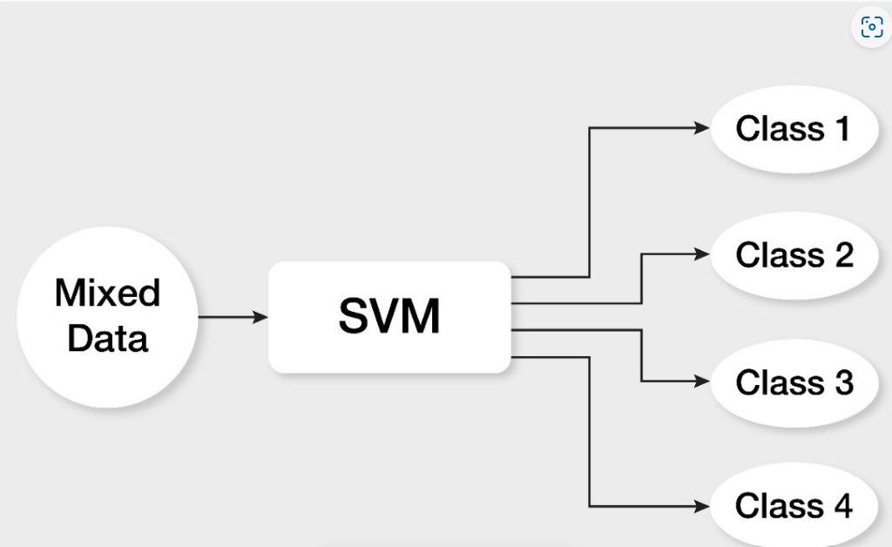
Introduction: Support Vector Machine
Support Vector Machine or SVM is one of the most popular Supervised Learning algorithms, which is used for Classification as well as Regression problems. However, primarily, it is used for Classification problems in Machine Learning.

Slide 4
Support Vector Machine Background
Support Vector Machine (SVM) is a supervised classification method derived from statistical learning theory that often yields good classification results from complex and noisy data. Supervised learning can be divided into two categories: classification and regression.
Classification is the process of finding or discovering a model or function which helps in separating the data into multiple categorical classes i.e. discrete values. Some examples of classification include spam detection, attrition rate prediction, sentiment analysis, dog breed detection and so on.

Slide 5
Support Vector Machine Background
SVM separates the classes with a decision surface that maximizes the margin between the classes. The surface is often called the optimal hyperplane, and the data points closest to the hyperplane are called support vectors. The support vectors are the critical elements of the training set.
In supervised learning (like SVM) algorithms learn from labeled data. After understanding the data, the algorithm determines which label should be given to new data by associating patterns to the unlabeled new data.

Slide 6
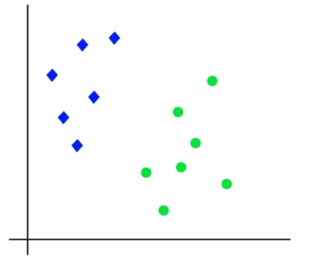
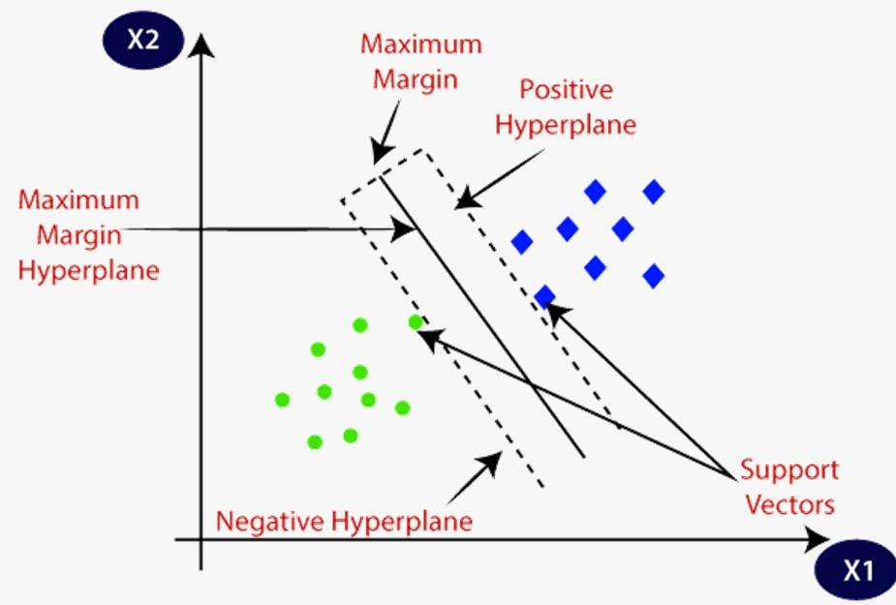
Support Vector Machine Algorithm
The goal of the SVM algorithm is to create the best line or decision boundary that can segregate n-dimensional space into classes so that we can easily put the new data point in the correct category in the future. This best decision boundary is called a hyperplane.
SVM chooses the extreme points/vectors that help in creating the hyperplane. These extreme cases are called as support vectors, and hence algorithm is termed as Support Vector Machine. Consider the below diagram in which there are two different categories that are classified using a decision boundary or hyperplane:

Slide 7
Support Vector, Hyperplane, and Margin
Vector: The vector points closest to the hyperplane are known as the support vector points because only these two points are contributing to the result of the algorithm, and other points are not.
Hyperplane: The dimension of the hyperplane depends upon the number of features. If the number of input features is 2, then the hyperplane is just a line. If the number of input features is 3, then the hyperplane becomes a two-dimensional plane. It becomes difficult to imagine when the number of features exceeds 3.
Marginal Distance: The distance of the vectors from the hyperplane is called the margin, which is a separation of a line to the closest class points. We would like to choose a hyperplane that maximises the margin between classes. The graph below shows what good margin and bad margin are.

Slide 8
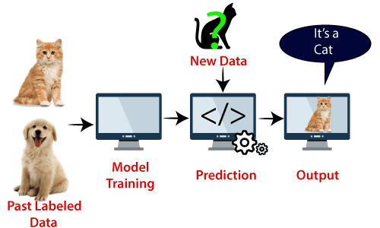
Example: Suppose we see a strange cat that also has some features of dogs, so if we want a model that can accurately identify whether it is a cat or dog, so such a model can be created by using the SVM algorithm. As support vector creates a decision boundary between these two data (cat and dog) and choose extreme cases (support vectors), it will see the extreme case of cat and dog. On the basis of the support vectors, it will classify it as a cat. Consider the below diagram:

Slide 9
Types of SVM
SVM can be of two types:
Linear SVM: Linear SVM is used for linearly separable data, which means if a dataset can be classified into two classes by using a single straight line, then such data is termed as linearly separable data, and classifier is used called as Linear SVM classifier.
Non-linear SVM: Non-Linear SVM is used for non-linearly separated data, which means if a dataset cannot be classified by using a straight line, then such data is termed as non-linear data and classifier used is called as Non-linear SVM classifier.

Slide 10
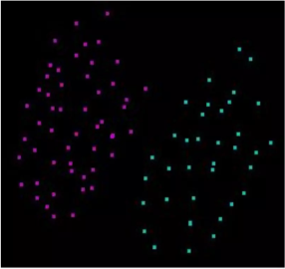
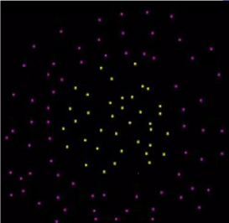
Linearly Separable Data
Non Linearly Separable Data

Slide 11
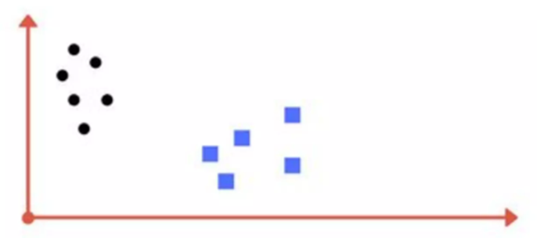
Linearly Separable Data
What could be drawn to classify the black dots from blue squares?

Slide 12
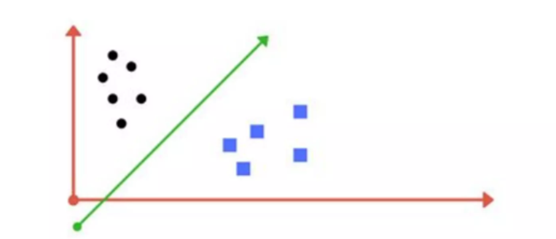
Linearly Separable Data
A line drawn between these data points classify the black dots and blue squares.

Slide 13
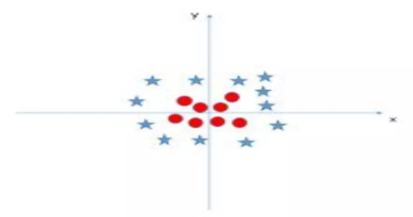
Non Linearly Separable Data
What could be drawn to classify the red dots from blue squares?

Slide 14
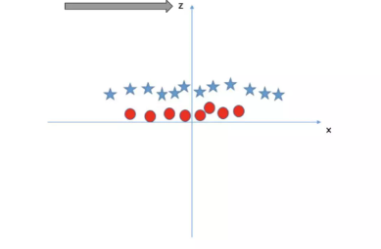
Non Linearly Separable Data
Here the hyperplane is a 2d plane drawn parallel to x-axis that is the separator.

Slide 15
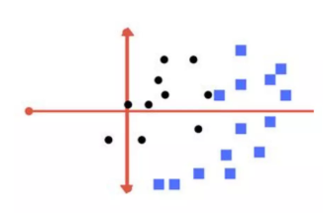
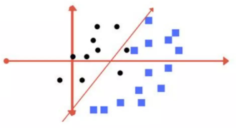
Non Linearly Data (type 2)
Raw Data
Line as Hyperplane

Slide 16
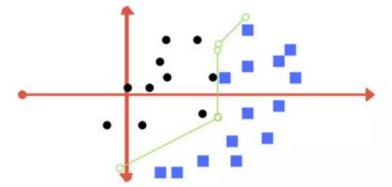
This type of separator best provides the classification.
But
• It is quite difficult to train a model like this
• This is termed as Regularisation parameter.

Slide 17
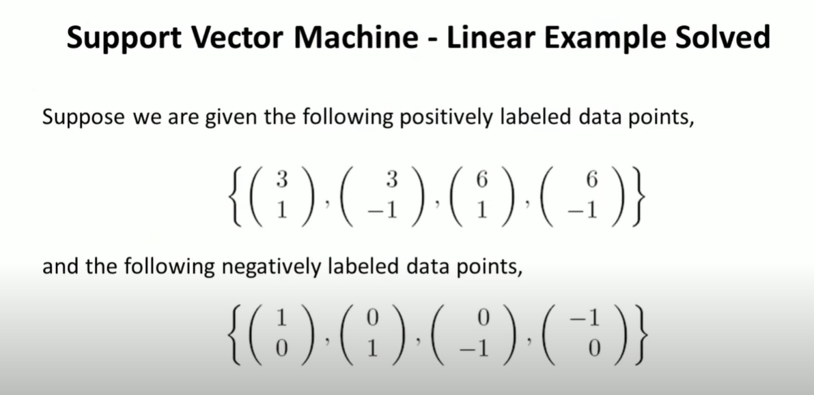
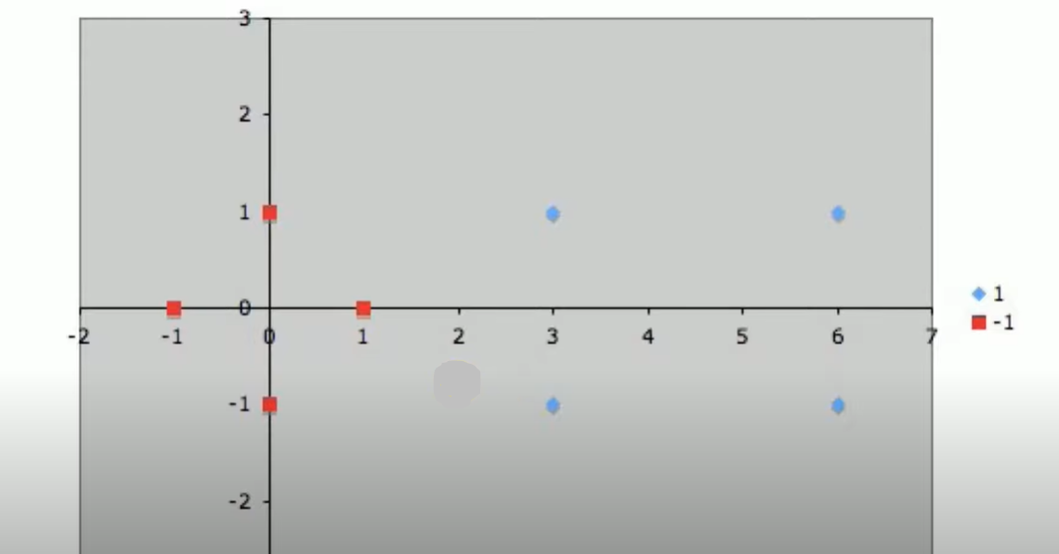
Support Vector Machine | Linear SVM Example

Slide 18
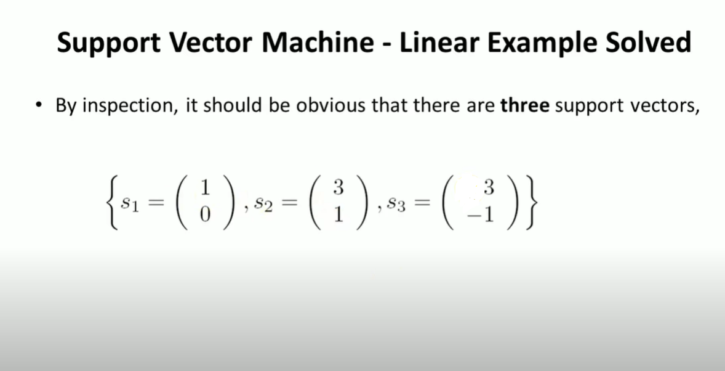
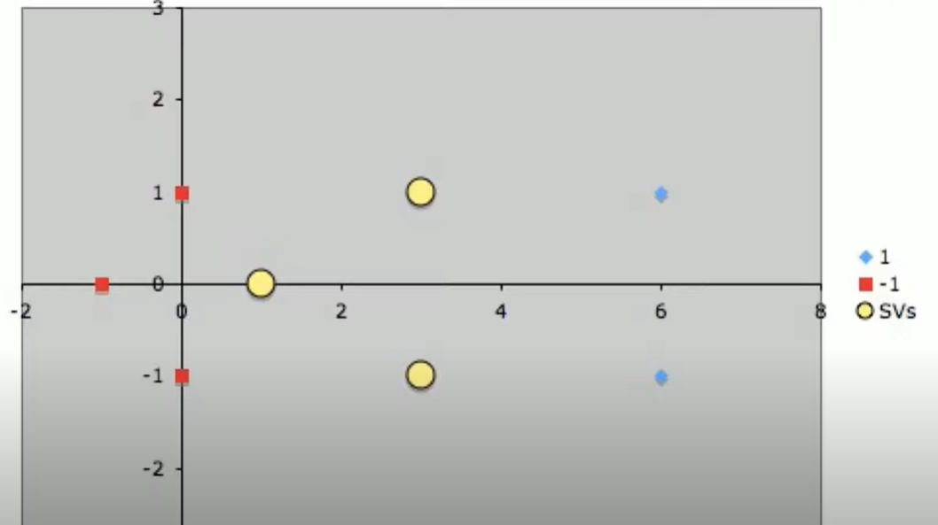

Slide 19
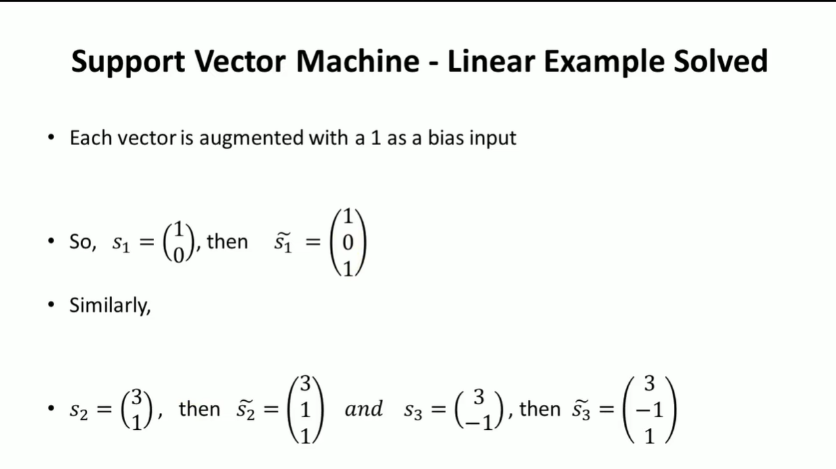

Slide 20
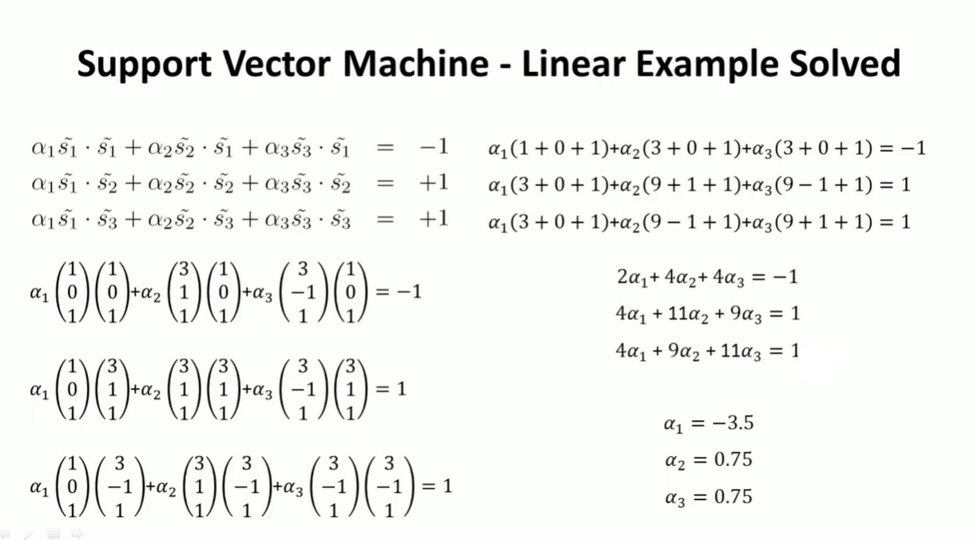

Slide 21
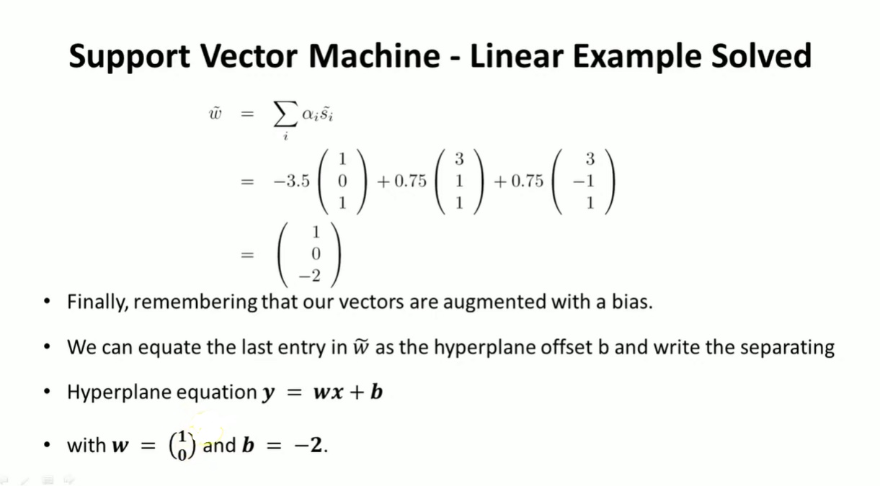

Slide 22
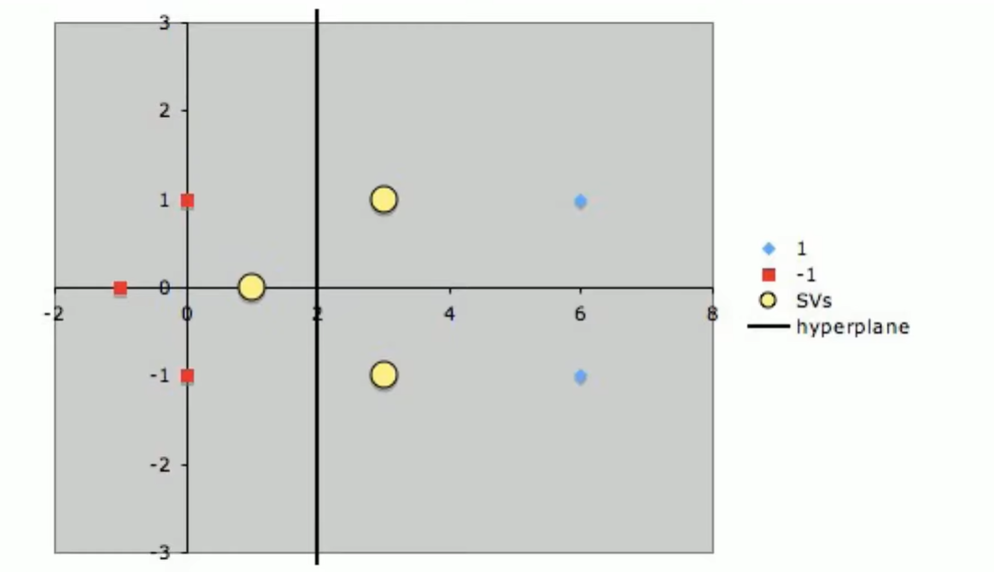

Slide 23
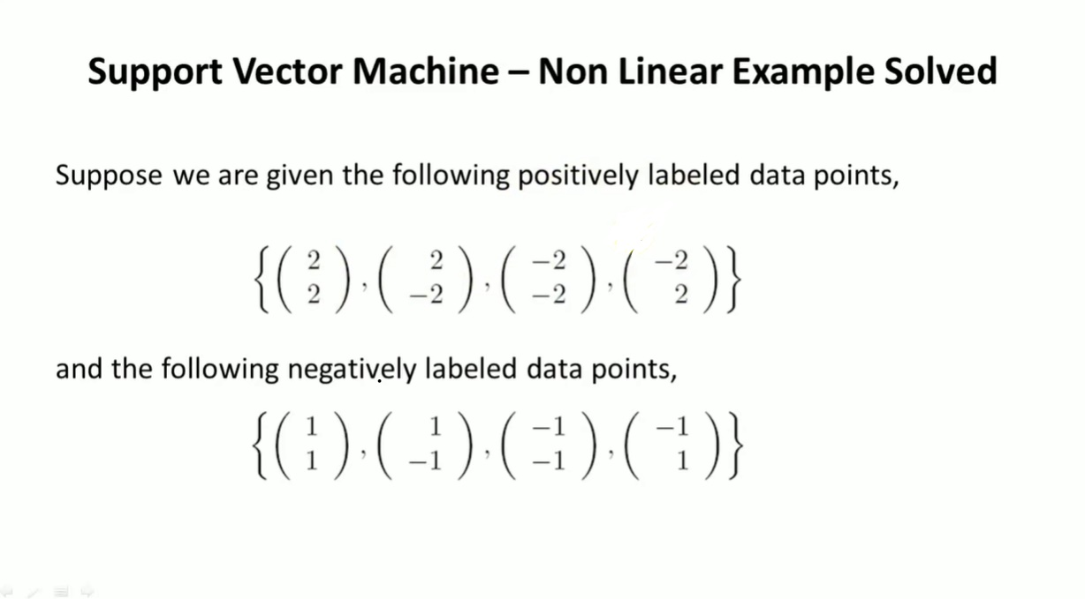
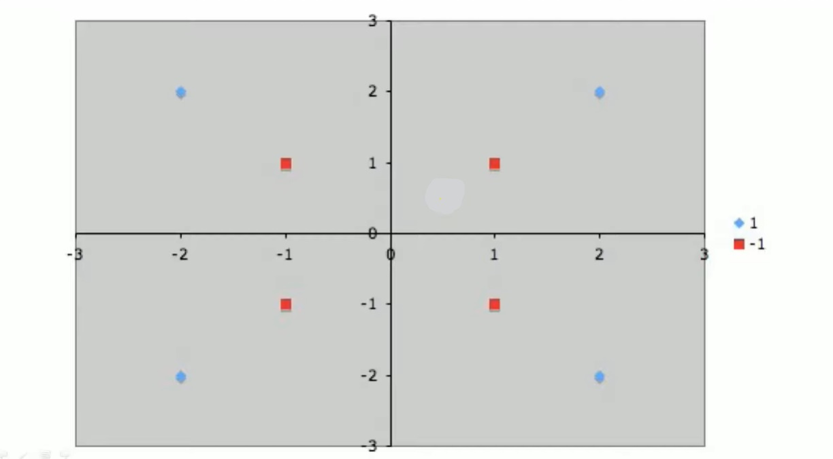
Support Vector Machine | Non-Linear SVM Example

Slide 24
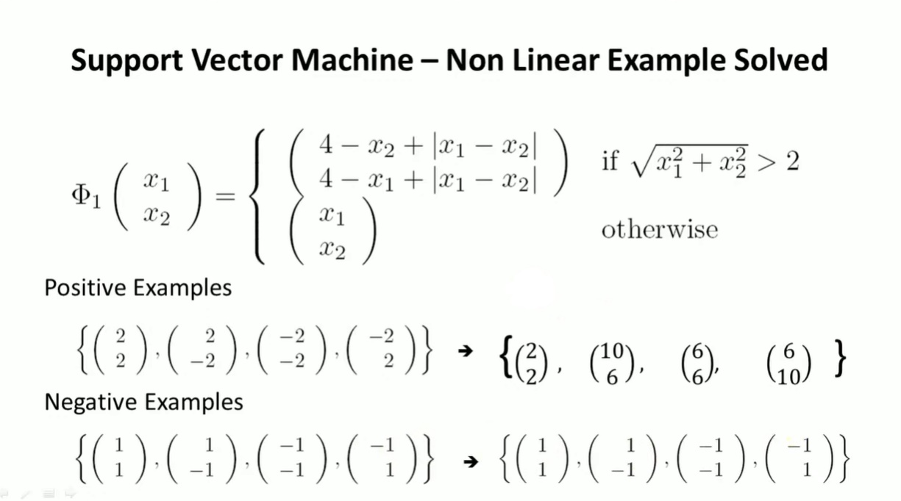

Slide 25
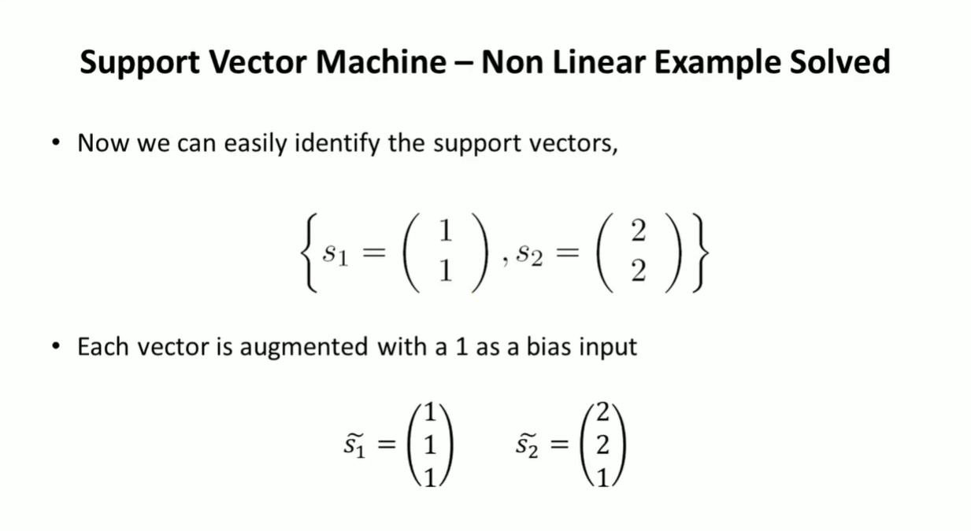

Slide 26
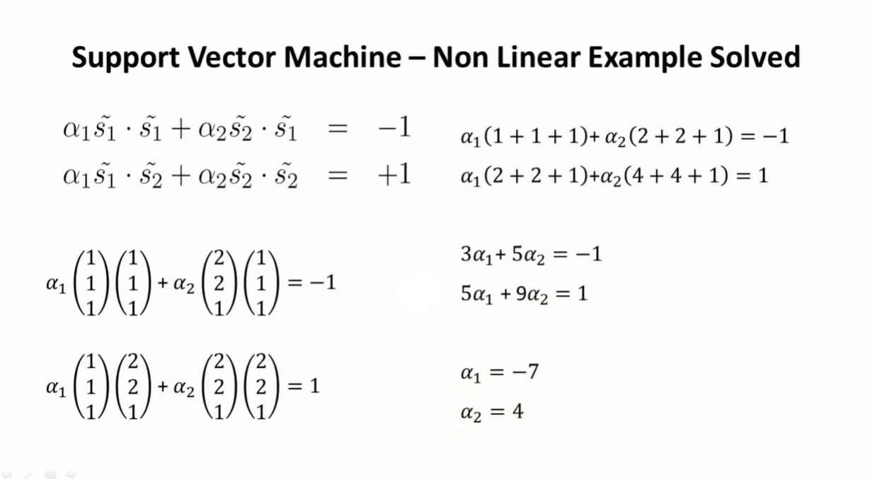

Slide 27
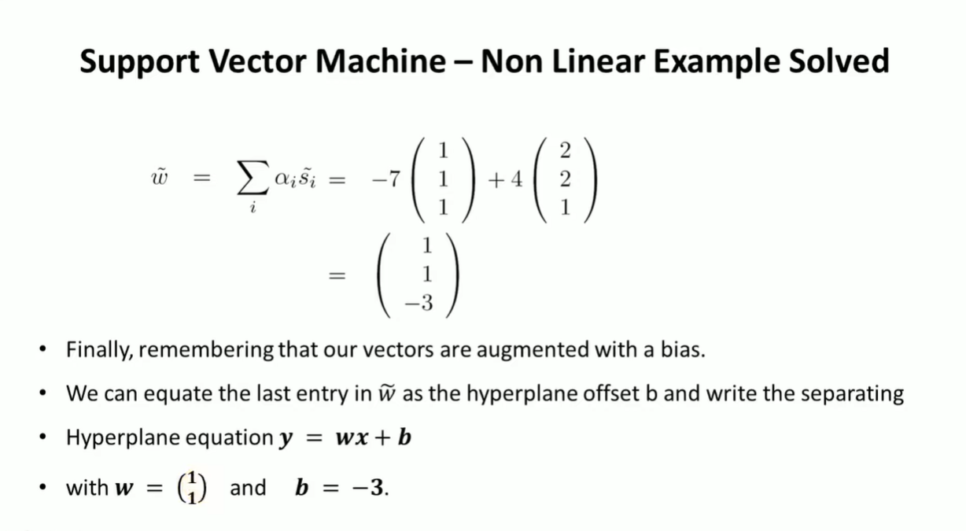

Slide 28
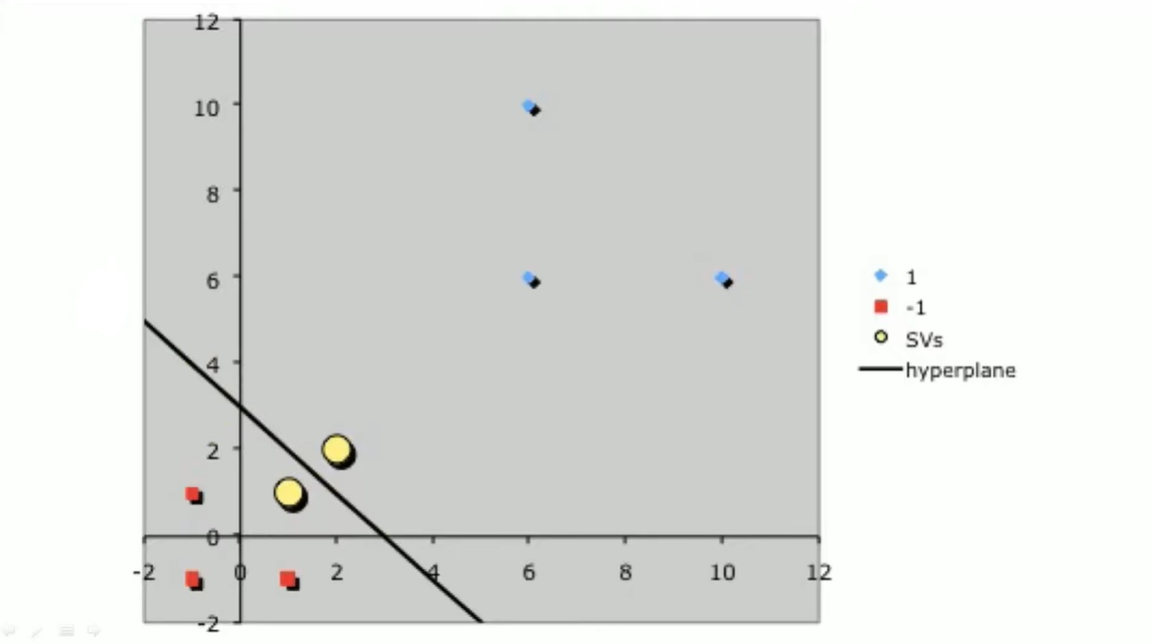

Slide 29
Pros:
It works really well with clear margin of separation
It is effective in high dimensional spaces.
It is effective in cases where number of dimensions is greater than the number of samples.
It uses a subset of training points in the decision function (called support vectors), so it is also memory efficient.

Slide 30
Cons:
It doesn't perform well, when we have large data set because the required training time is higher
It also doesn't perform very well, when the data set has more noise i.e. target classes are overlapping
SVM doesn't directly provide probability estimates, these are calculated using an expensive five-fold cross-validation. It is related SVC method of Python scikit-learn library.

Slide 31
Applications:
1. Face detection
2. Text and hypertext categorization
3. Classification of images
4. Bioinformatics
5. Handwriting recognition
6. Protein fold and remote homology detection
7. Generalized predictive control(GPC)

Slide 32
Conclusion
SVM is a supervised learning algorithm which separates the data into different classes through the use of a hyperplane. The chosen hyperplane is one with the greatest margin between the hyperplane and all points, this yields the greatest likelihood of accurate classification. It’s a very versatile, memory efficient algorithm, however it’s prone to overfitting, can be computationally expensive depending on the size of the data and fails to provide a probabilistic explanation of the results.

Slide 33
